Slide 1
Object Oriented Programming and Design
Presented by
Dr Ramya Devi M
mramyadevi@wilp.bits-pilani.ac.in
CS - 11 : 04th Oct 2025

Slide 2

IMP Note to Self

Slide 3
EXCEPTION HANDLING

Slide 4
Learning Objectives
What is an Exception?
Types of Exception
Exception Handling ( try and catch blocks)
Usage of finally block
Multiple catch blocks
Usage of throws clause
Creating our own exception
Object Oriented Programming

Slide 5
EXCEPTION
What is an exception?
An Exception is an unwanted event that interrupts the normal flow of the program.
When an exception occurs program execution gets terminated.
In such cases we get a system generated error message.
The good thing about Java is that exceptions can be handled.
By handling the exceptions we can provide a meaningful message to the user about the issue rather than a system generated message, which may not be understandable to a user.
Object Oriented Programming

Slide 6
EXCEPTION
Why an exception occurs?
There can be several reasons that can cause a program to throw exception.
For example: Opening a non-existing file in our program, Network connection problem, bad input data provided by user etc.
Exception Handling
Exception handling is one of the most important feature of java programming that allows the users to handle runtime errors caused by exceptions.
If an exception occurs, which has not been handled by programmer then program execution gets terminated and a system generated error message is shown to the user.
Object Oriented Programming

Slide 7
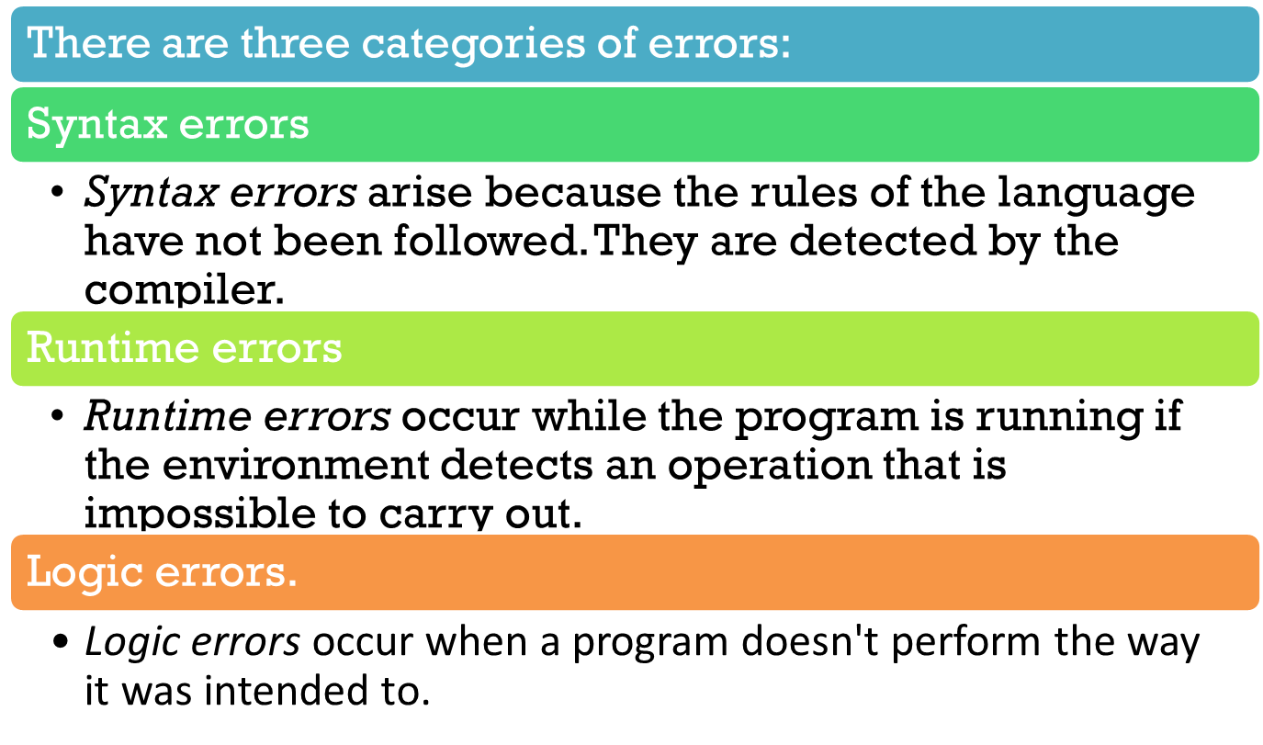
Types of Errors

Slide 8
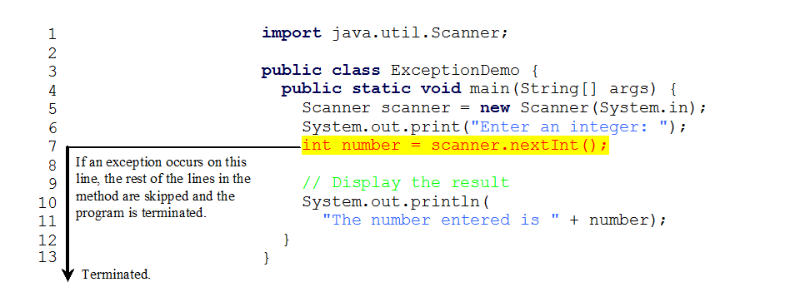
Runtime Errors

Slide 9
Exception-Handling Fundamentals
An exception is an abnormal condition that arises in a code sequence at run time
A Java exception is an object that describes an exceptional condition that has occurred in a piece of code
When an exceptional condition arises, an object representing that exception is created and thrown in the method that caused the error
An exception can be caught to handle it or pass it on
Exceptions can be generated by the Java run-time system, or they can be manually generated by your code
A program can be separated into a normal execution flow and an exception execution flow

Slide 10
Exception Handling
Java has a predefined set of exceptions and errors that can occur during execution
A program can deal with an exception in one of three ways:
  ignore it
  handle it where it occurs
  handle it an another place in the program
The manner in which an exception is processed is an important design consideration

Slide 11
Exception Types
All exception types are subclasses of the built-in class Throwable
The java.lang.Throwable class is the root class of Java Exception hierarchy.
Throwable has two subclasses, they are
  Exception (to handle exceptional conditions that user programs should catch)
    An important subclass of Exception is RuntimeException, that includes division by zero and invalid array indexing
  Error (to handle exceptional conditions that are not expected to be caught under normal circumstances). i.e. stack overflow
An error is also represented as an object in Java, but usually represents a unrecoverable situation and should not be caught.
corrective actions.

Slide 12
Difference between error and exception
Errors indicate that something severe enough has gone wrong, that the application should crash rather than try to handle the error.
Exceptions are events that occurs in the code.
A programmer can handle such conditions and take necessary corrective actions.

Slide 13
Advantages of exception handling
Exception handling ensures that the flow of the program
doesn’t break when an exception occurs.
For example, if a program has bunch of statements and an exception occurs mid way after executing certain statements then the statements after the exception will not execute and the program will terminate abruptly.
By handling the exceptions, we make sure that all the statements execute and the flow of program doesn’t break.
Object Oriented Programming

Slide 14
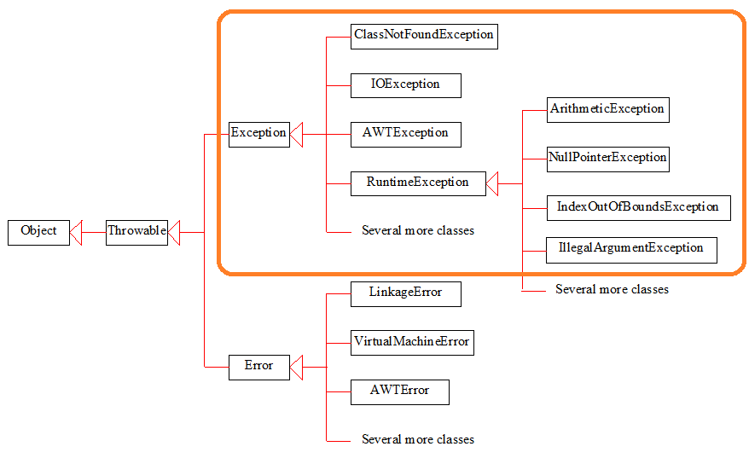
Exception Classes in Java
Exception describes errors caused by your program and external circumstances.
These errors can be caught and handled by your program.

Slide 15
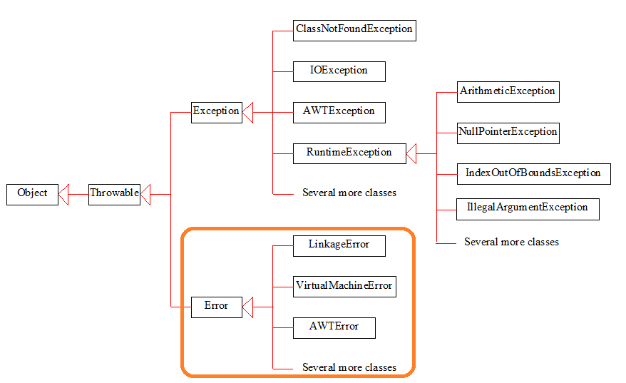
System Errors
System errors are thrown by JVM and represented in the Error class.
The Error class describes internal system errors.
Such errors rarely occur.
If one does, there is little you can do beyond notifying the user and trying to terminate the program gracefully.

Slide 16
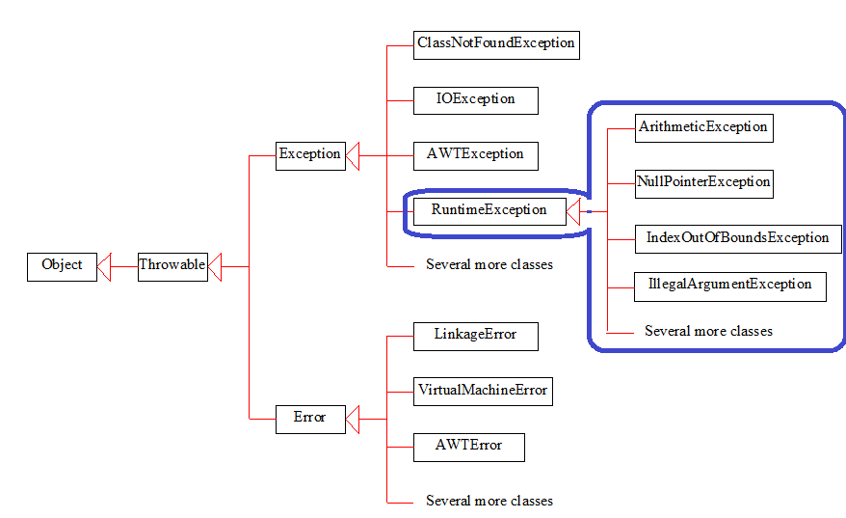
Runtime Exceptions
RuntimeException is caused by programming errors, such as bad casting, accessing an out-of-bounds array, and numeric errors.

Slide 17
EXCEPTION - Examples
Few examples:
NullPointerException
– When we try to use a reference that points to null.
ArithmeticException
– When bad data is provided by user, for example, when we try to divide a number by zero this exception occurs because dividing a number by zero is undefined.
ArrayIndexOutOfBoundsException
– When we try to access the elements of an array out of its bounds, for example array size is 5 (which means it has five elements) and we are trying to access the 10th element.
Object Oriented Programming

Slide 18
Hierarchy of Java Exception classes
The java.lang.Throwable class is the root class of Java Exception hierarchy.
It is inherited by two subclasses:
Exception and
Error.
The hierarchy of Java Exception classes is given below:

Slide 19
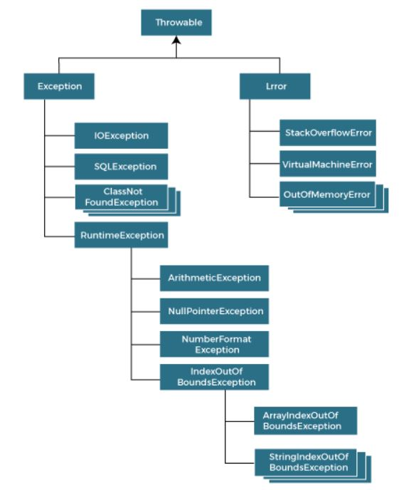
Hierarchy of Java Exception classes

Slide 20
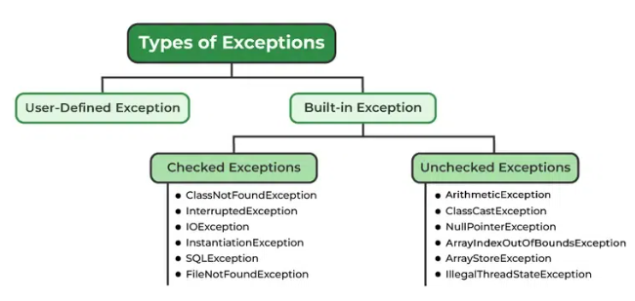
EXCEPTION - Types
Types of exceptions
There are two types of exceptions in Java:
1)Checked exceptions - Checked exceptions are exceptions that are checked at compile-time by the Java compiler. (FileNotFoundException)
2)Unchecked exceptions - Unchecked exceptions are exceptions that are not checked at compile-time by the Java compiler. (ArithmeticException)
Object Oriented Programming

Slide 21
EXCEPTION - Types
Checked exceptions
All exceptions other than Runtime Exceptions are known as Checked exceptions.
The compiler checks them during compilation to see whether the programmer has handled them or not.
If these exceptions are not handled/declared in the program, you will get compilation error.
For example, SQLException, IOException, ClassNotFoundException etc., if not handled in code generates compilation errors.
Object Oriented Programming

Slide 22
EXCEPTION
Unchecked Exceptions
Runtime Exceptions are also known as Unchecked Exceptions.
These exceptions are not checked at compile-time.
The compiler does not check whether the programmer has handled them or not.
It is the responsibility of the programmer to handle these exceptions and provide a safe exit.
For example, ArithmeticException, NullPointerException,
ArrayIndexOutOfBoundsException etc.
Compiler will never force us to catch such exception or force
us to declare it in the method using throws keyword.
Object Oriented Programming

Slide 23
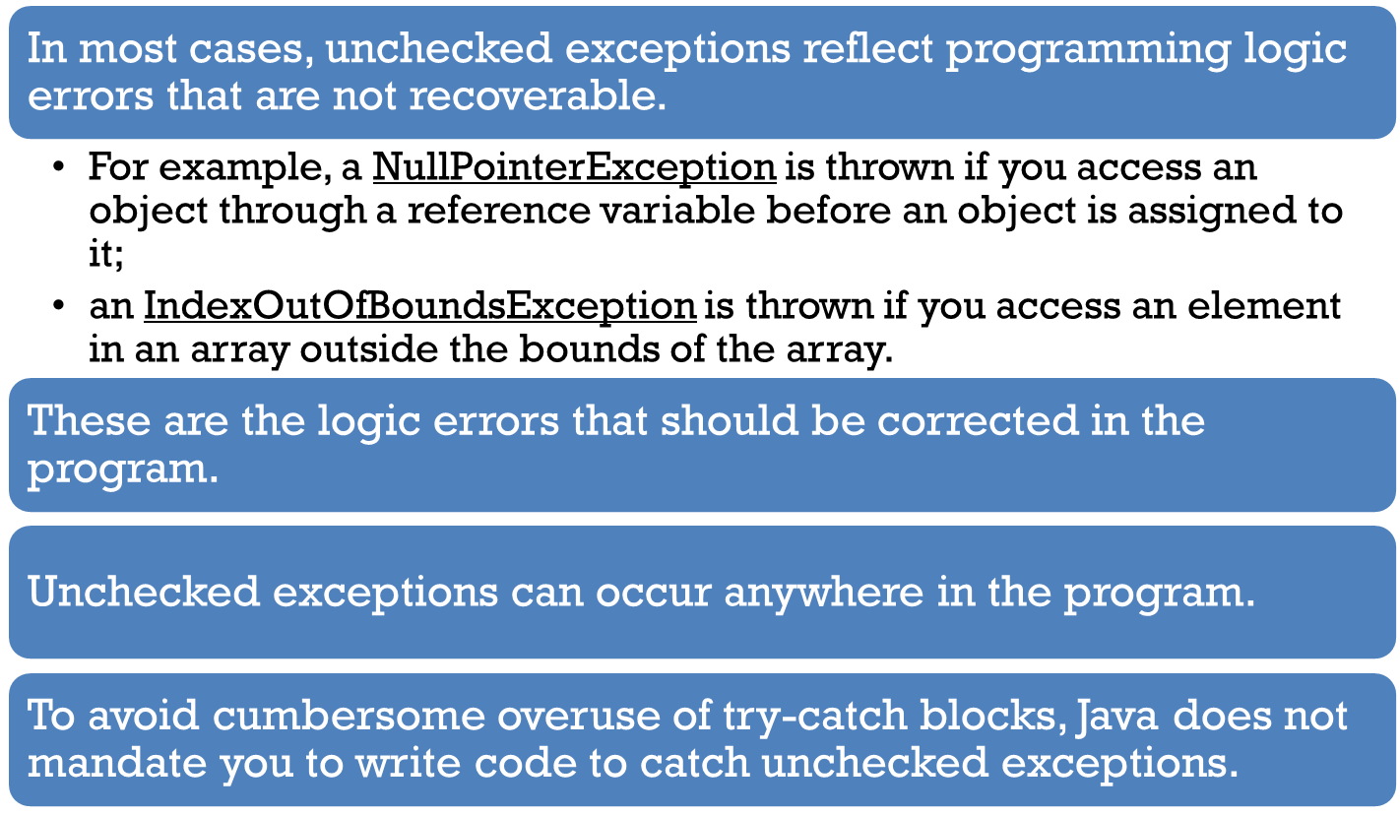
Unchecked Exceptions

Slide 24
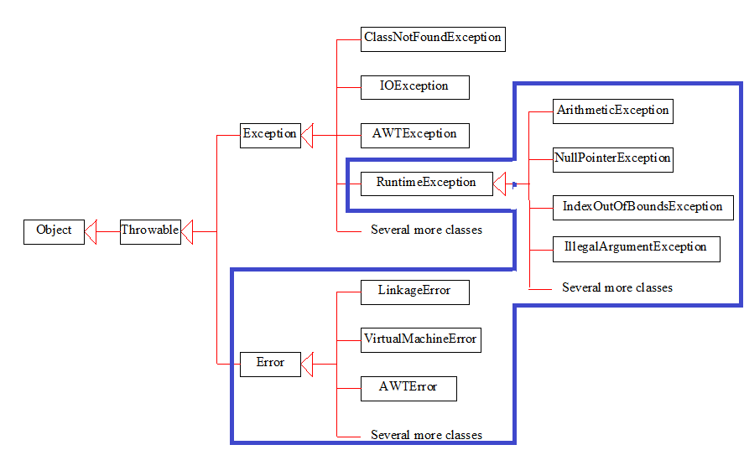
Checked or Unchecked Exceptions
Unchecked exception.

Slide 25
Exception-Handling Fundamentals
Java exception handling is managed by via five keywords: try, catch, throw, throws, and finally
Program statements to monitor are contained within a try block
If an exception occurs within the try block, it is thrown
Code within catch block catch the exception and handle it
System generated exceptions are automatically thrown by the Java run-time system
To manually throw an exception, use the keyword throw
Any exception that is thrown out of a method must be specified as such by a throws clause
Two approaches for dealing with checked exceptions
Declare the exception in the method header (preferred)
  Catch the exception

Slide 26
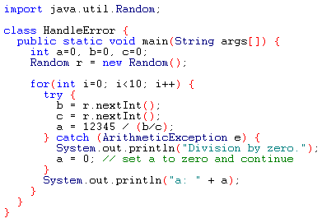
Using try and catch
A try and catch statement form a unit. The scope of the catch clause is restricted to those statements specified by the immediately preceding try statement

Slide 27
Using try and catch
Handling an exception has two benefits,
  It allows you to fix the error
  It prevents the program from automatically terminating
The catch clause should follow immediately the try block
Once an exception is thrown, program control transfer out of the try block into the catch block
Once the catch statement has executed, program control continues with the next line in the program following the entire try/catch mechanism

Slide 28
try – catch block
The try statement allows us to define a block of code to be tested for errors while it is being executed.
The catch statement allows you to define a block of code to be executed, if an error occurs in the try block.
The statements try and catch occur in pair.
The Syntax for try block is
try
{
Block for try // Include the statement in which we expect the error
}
catch(Exception e)
{
Block for catch // Remedial statements for the error
}
Object Oriented Programming

Slide 29
Example
Consider the following example:
class DemoException
{
public static void main(String aa[] )
{
int [ ] a = {10,20,30};
System.out.prinltn(a[5]);
}
}
Object Oriented Programming

Slide 30
EXCEPTION
It displays an error message as follows:
Exception in thread “main”
java.lang.ArrayIndexOutOfBoundsException : 5 at
DemoException (DemoException.java: 4)
If an error occurs, we can use try...catch to catch the error and
execute some code to handle it.
Note : We can include a finally block after catch block.
The finally block lets us to execute code, after try...catch,
regardless of the result:
Object Oriented Programming

Slide 31
Handling the exception using try – catch block
class DemoException
{
public static void main(String aa[] )
{
int [ ] a = {10,20,30};
try
{
System.out.prinltn(a[5]);
}
catch(Exception e)
{
System.out.prinltn(“ Index out of Boundary, it must lie between 0 to 9”);
}
}
}
The output will be: Index out of Boundary, it must lie between 0 to 9
Object Oriented Programming

Slide 32
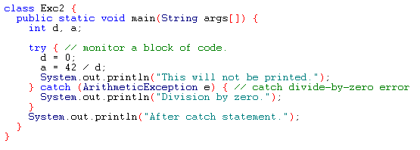
Example – Using try-catch block
Output:
Division by zero.
After catch statement.

Slide 33
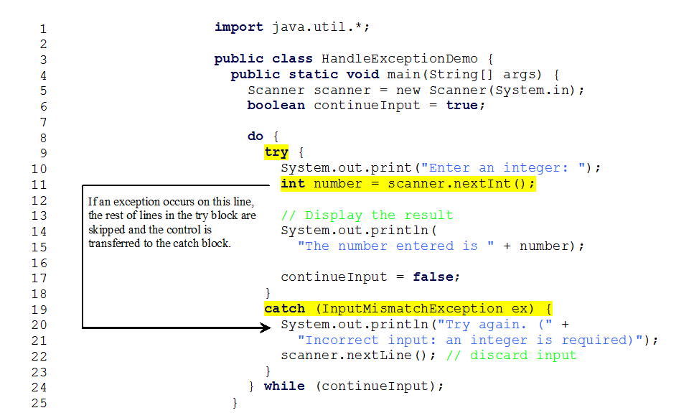
Catch Runtime Errors

Slide 34
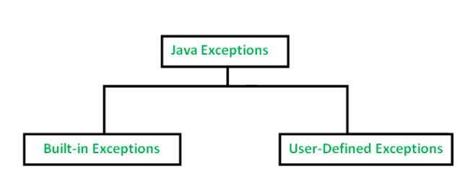
Types of Exception in Java with Examples

Slide 35
The finally block
Any code that absolutely must be executed before a method returns is put in a finally block
General form of an exception-handling block
try{
// block of code to monitor for errors
}
catch (ExceptionType1 exOb){
// exception handler for ExceptionType1
}
catch (ExceptionType2 exOb){
// exception handler for ExceptionType2
}
//…
finally{
// block of code to be executed before try block ends
}

Slide 36
The finally block
public class FinallyExample {
public static void main(String[] args) {
try {
System.out.println("Inside try block");
int result = 10 / 0;
System.out.println("This line will not execute");
} catch (ArithmeticException e) {
System.out.println("Exception caught: " + e.getMessage());
} finally {
System.out.println("Finally block executed");
}
System.out.println("Program continues...");
}
}

Slide 37
Example Without Exception:
public class FinallyExampleNoException {
public static void main(String[] args) {
try {
System.out.println("Inside try block");
int result = 10 / 2;
System.out.println("Result: " + result);
} finally {
System.out.println("Finally block executed");
}
System.out.println("Program continues...");
}
}

Slide 38
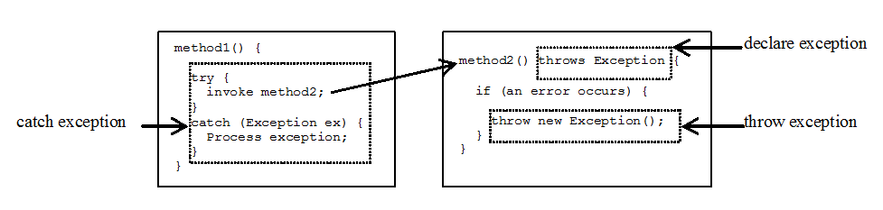
Declaring, Throwing, and Catching Exceptions

Slide 39
throw keyword
Usage of the throw keyword
The throw statement allows us to create a custom error.
The throw statement is used together with an exception type.
There are many exception types available in Java:
ArithmeticException, FileNotFoundException,
ArrayIndexOutOfBoundsException, SecurityException, etc:
Example
Throw an exception if salary is above 50,000 (print "No Bonus").
If salary is lesser than or equal to 50,000, print "You Will get Bonus":
Object Oriented Programming

Slide 40
throw - Example
It displays the error message as
Exception in thread “main” java.lamg.ArithmeticException :
No Bonus at ExceptionDemo.check (ExceptionDemo.java:4_ at
ExceptionDemo.main (ExceptionDemo.java:12)
Object Oriented Programming

Slide 41
throws keyword
Use of throws Keyword
The keyword “throws” in the method header is used to specify that the method causes an exception so that the caller who calls this method can guard themselves against that exception.
The Syntax for using throws keyword is
Return Type method name (parameter list) throws Exception name
{
Body of the method
}
Object Oriented Programming

Slide 42
throws keyword
Execution of the above code
CASE 1: Let us assume that the input is given as 28,
The output is
You are allowed to work…
CASE 2: Let us assume that the input is given as 70
There is no output and it displays the error message as
Catching : java.lang.ArithmeticException : Invalid Age to work …
Object Oriented Programming

Slide 43
Multiple catch blocks
In some cases , a single code may raise more than one exceptions.
To handle this situation, we can specify two or more catch blocks, each catching a different type of exception.
The following example demonstrates the use of multiple catch blocks for handling different types of exceptions.
Object Oriented Programming

Slide 44
CUSTOMIZED EXCEPTIONS
CREATING OUR OWN EXCEPTION
Java provides rich set of built-in exception classes like:
ArithmeticException, IOException, NullPointerException etc. which are available in the java.lang package and used in exception handling.
These exceptions are already set to trigger on pre-defined conditions such as when you divide a number by zero it triggers ArithmeticException.
Apart from these classes, Java allows us to create our own exception class to provide own exception implementation.
Object Oriented Programming

Slide 45
CUSTOMIZED EXCEPTIONS
These type of exceptions are called user-defined exceptions or custom exceptions.
We can create our own exception simply by extending java Exception class.
We can define a constructor for our Exception (not compulsory) and we can override the toString() function to display your customized message on catch.
Object Oriented Programming

Slide 46
Nested try Statements
A try statement can be inside the block of another try
Each time a try statement is entered, the context of that exception is pushed on the stack
If an inner try statement does not have a catch, then the next try statement’s catch handlers are inspected for a match
If a method call within a try block has try block within it, then then it is still nested try

Slide 47
Thanks

